Slide 1

Unit-1 Introduction to Symmetric Cipher, Stream Ciphers, and Block Ciphers
Information & Network Security (INS)
DU #2301CS631
Course Outcome:
Demonstrate symmetric ciphers, stream ciphers and block ciphers.
Prof. Maulik D. Trivedi
Computer Engineering Department
maulik.trivedi@darshan.ac.in
9998 265 805
Disclaimer: The images used in this presentation are sourced solely for educational and nonprofit purposes. The author of this presentation asserts no ownership or copyright claims over them."

Slide 2

Looping
Outline
Introduction of Information Security
Security Attacks, Services, Mechanism
Symmetric Cipher Model
Basics of Cryptography
Cryptanalysis and Attacks
Substitution and Transposition Techniques
Stream Ciphers & Block Ciphers
Block Cipher Structure

Slide 3
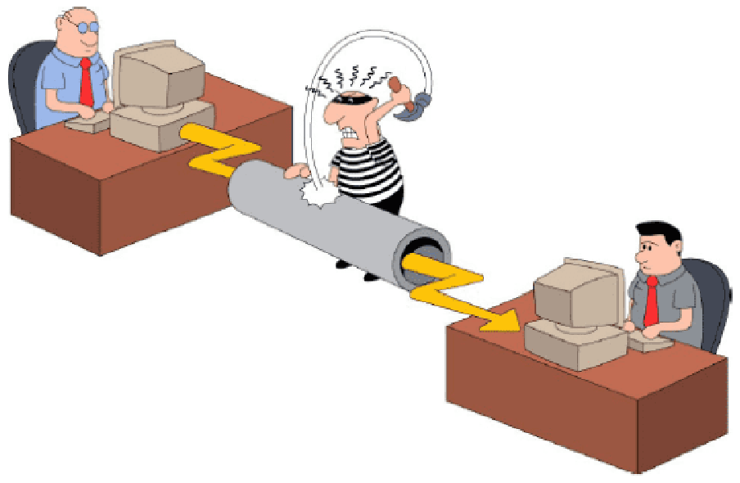
Introduction to Information & Network Security

Slide 4
Information & Network Security
What is Information ?
The processed form of data or meaningful data is called information. Basically, information is the message that is being conveyed.
What is Security ?
Computer Security: Generic name for the collection of tools designed to protect data.
Network and Internet Security: Measures to protect data during their transmission over a collection of interconnected networks.
Data
Process
Information

Slide 5
Key Security Objectives
Goal/Objectives of Security :
Confidentiality
Integrity
Availability
Authenticity
Accountability

Slide 6




Confidentiality
Confidentiality:
Data confidentiality: Assure confidential information not made available to unauthorized individuals.
Example: Individual files are locked and secured
Bob
Alice
Packet sniffing, illegal copying
Attacker

Slide 7
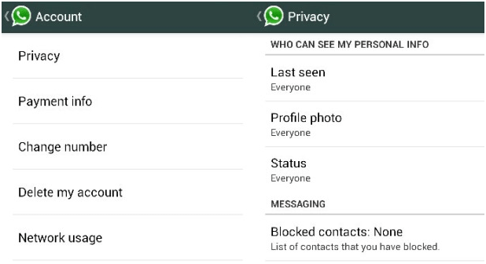
Confidentiality
Privacy: Assure individuals can control what information related to them is collected, stored, distributed.
Privacy is the right of an individual to protect personal or sensitive information.

Slide 8
Integrity
Integrity:
Data integrity: Assure information and programs are changed only in a authorized manner.
Message
Bob
Alice
Modifies the message, or Inserts a new one.
Message
How can Bob be sure that message really comes from Alice?
Attacker

Slide 9
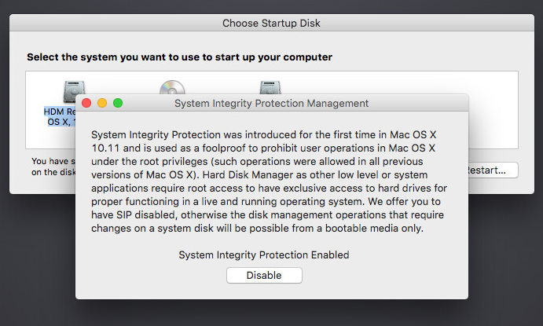
Integrity
System integrity: Assure system performs intended function.

Slide 10




Availability
Availability:
Assure that systems work promptly and service is not denied to authorized users.
www.amazon.com
User
Browser working
Server down

Slide 11



Authenticity
Authenticity:
The property of being genuine and being able to be verified and trusted; confidence in the validity of a transmission, a message, or message originator.
This means verifying that each input arriving at the system came from a trusted source.
Password
+
Verification
=
Access

Slide 12


Authenticity
Transfer Rs. 1,00,000
From A to C.
I am User A
User A
Bank
User C

Slide 13
Accountability
Accountability:
Accountability is about making sure that actions can be clearly linked to the right person. It helps ensure that no one can say they did not do something.
This supports nonrepudiation(assurance that someone cannot deny something).
Transfer Rs. 1,00,000
to Bank
User A
Bank

Slide 14
Impact of Security Breaches
Security breaches occur when unauthorized parties access protected data, systems, or networks.
Their impacts can be wide-ranging and severe for individuals, organizations, and even nations.
Financial loss
Example: The cost of repairing a company database once it’s been compromised.

Slide 15
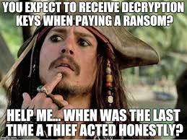
Impact of Security Breaches – Cont.
Damage to assets
Example: Hackers compromised Amazon Web Services account and demanded a ransom. When the company declined, the hacker started destroying their resources.

Slide 16
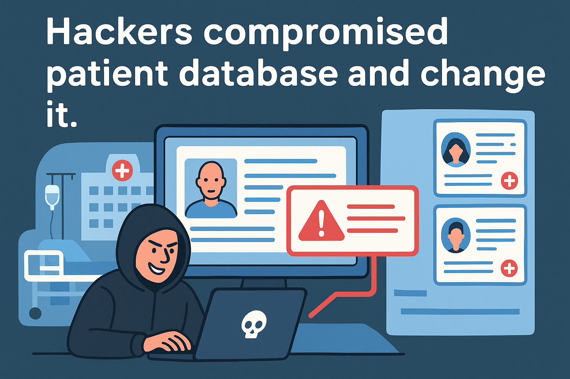
Impact of Security Breaches – Cont.
Harm to individuals
Example: Hackers compromised patience database and change it.

Slide 17
OSI Security Architecture
Systematic approach to define requirements for security and approaches to satisfying those requirements.
The OSI (Open Systems Interconnection) security architecture focuses on Security Attacks, Mechanisms, and Services.
Security Attack: Any action that compromises the security of information owned by an organization.
Security Mechanism: A process that is designed to detect, prevent, or recover from a security attack.
Security Service: A communication service that enhances the security of the data processing systems and the information transfers of an organization.

Slide 18
Security Attack

Slide 19
Security Attacks
A passive attack attempts to learn or make use of information from the system but does not affect system resources.
Release of message contents
Traffic analysis
Relatively hard to detect, but easier to prevent.
An active attack attempts to alter system resources or affect their operation.
Masquerade
Replay
Modification of messages
Denial of service.
Relatively hard to prevent, but easier to detect

Slide 20
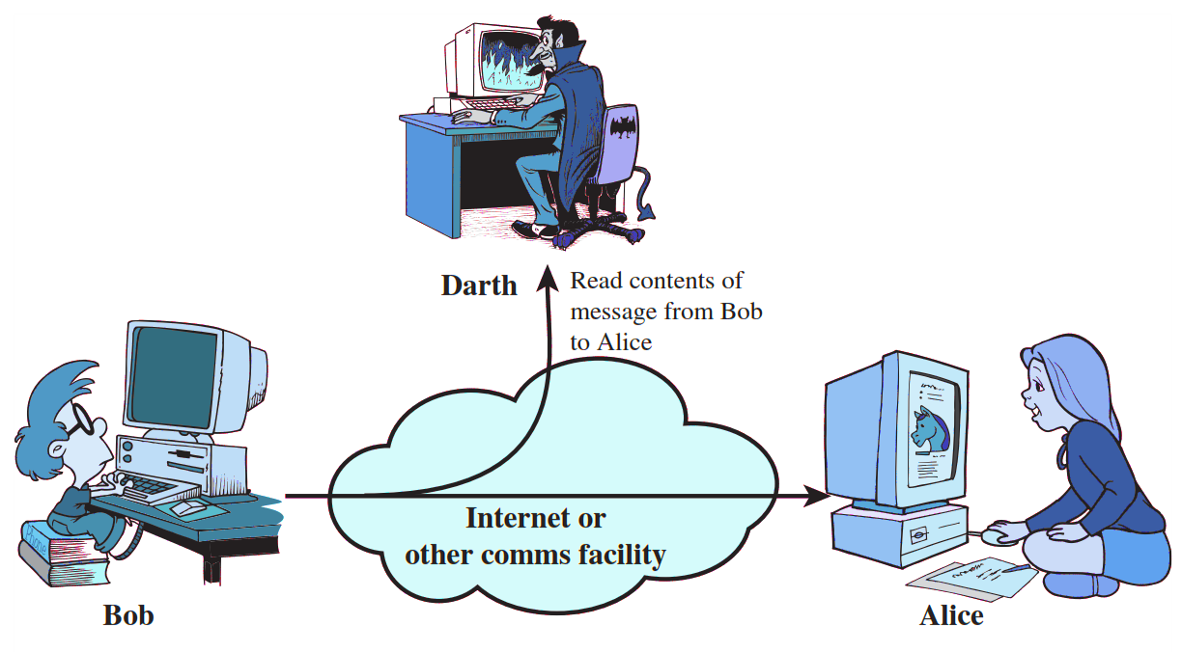
Release of Message Contents (Passive Attack)
A telephone conversation, an electronic mail message, and a transferred file may contain sensitive or confidential information.
We would like to prevent an opponent from learning the contents of these transmissions.
Attack on Confidentiality.

Slide 21

Traffic Analysis (Passive Attack)
In such attacks, an attacker analyses the traffic and observes the frequency and length of exchanged messages.
He uses all this information to predict the nature of communication.
Studying the flow of "traffic" to find patterns of behaviour.

Slide 22
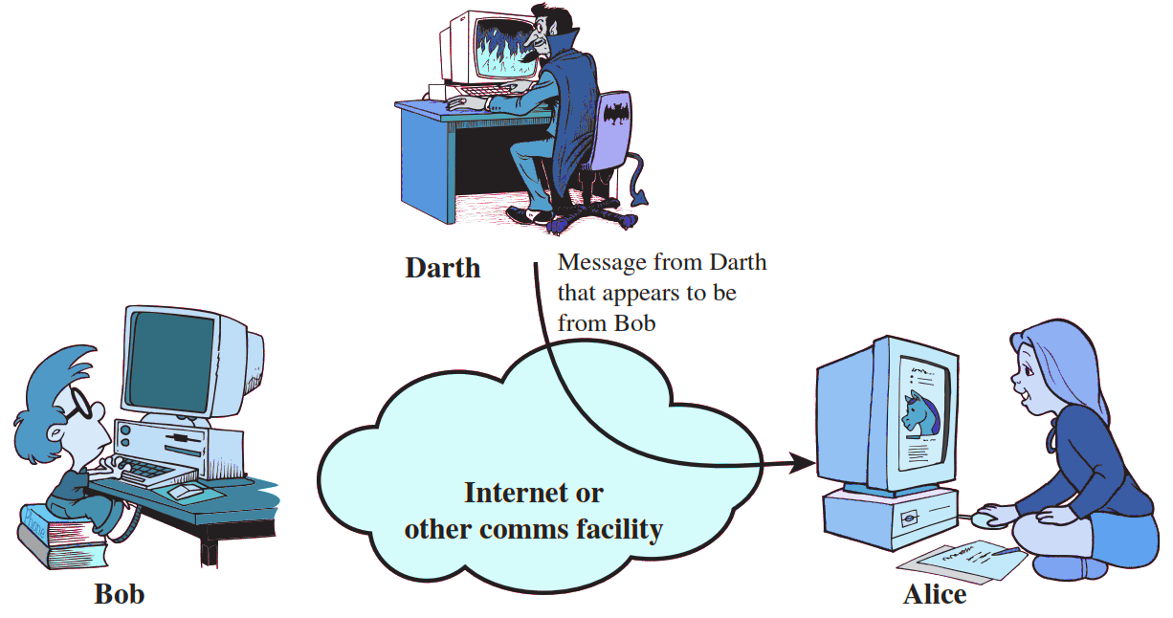
Masquerade Attack (Active Attack)
A masquerade takes place when one entity pretends to be a different entity.
A masquerade attack is an attack that uses a fake identity to gain unauthorized access to personal information.
Attack on Authentication.

Slide 23
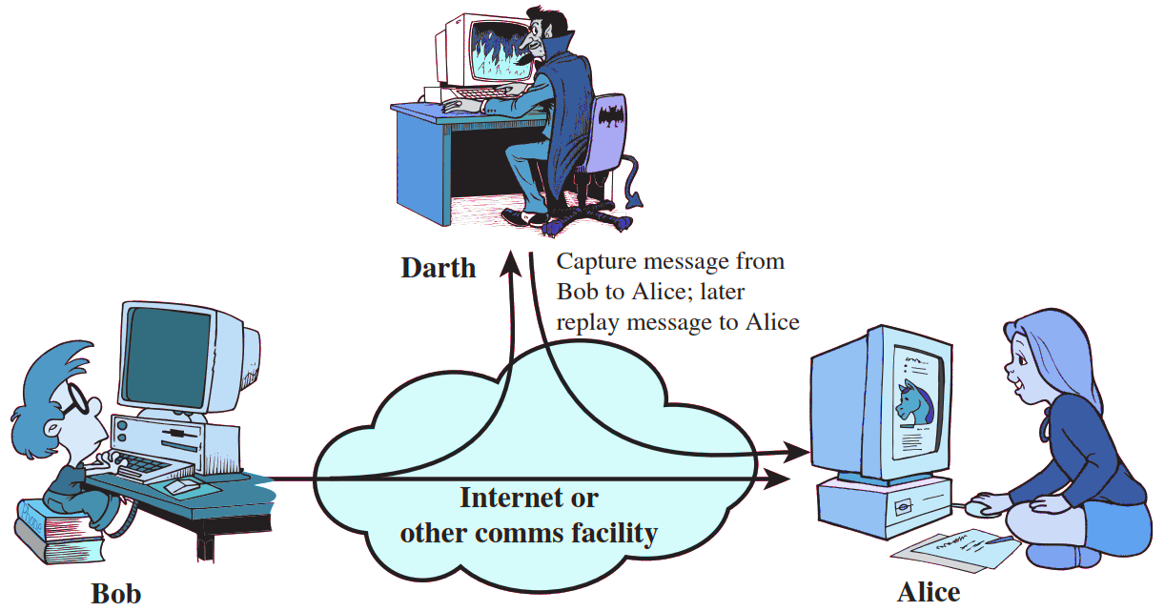
Replay Attack (Active Attack)
Replay attack involves the passive capture of a data unit and its subsequent retransmission to produce an unauthorized effect.
Replay attack is to replay the message sent to a network by an attacker, which was earlier sent by an authorized user.

Slide 24
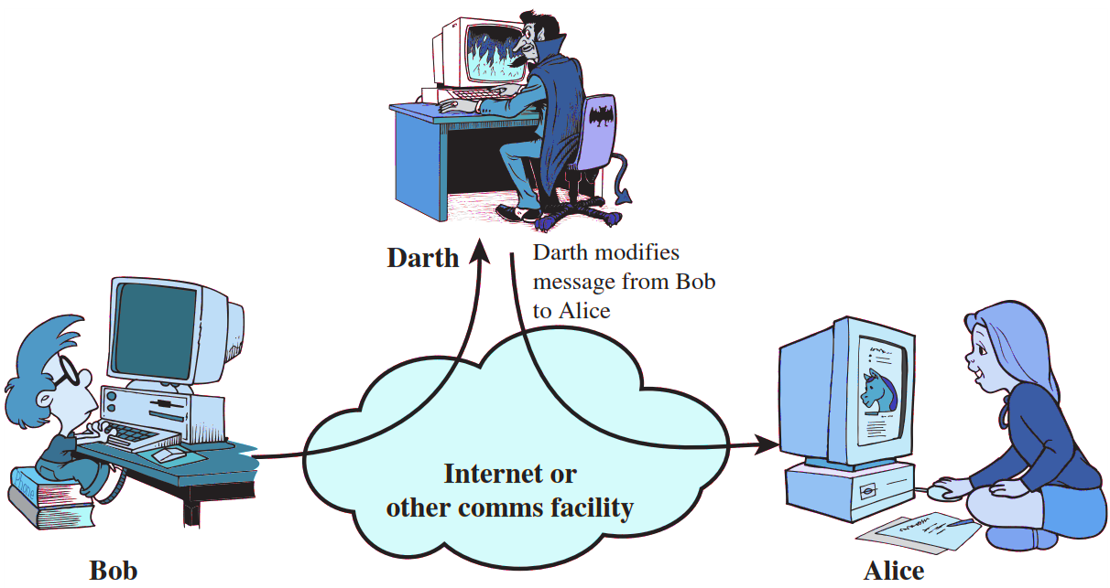
Modification of Messages Attack (Active Attack)
Modification of messages simply means that some portion of a legitimate message is altered, or that messages are delayed or reordered, to produce an unauthorized effect.
Attack on Integrity.

Slide 25
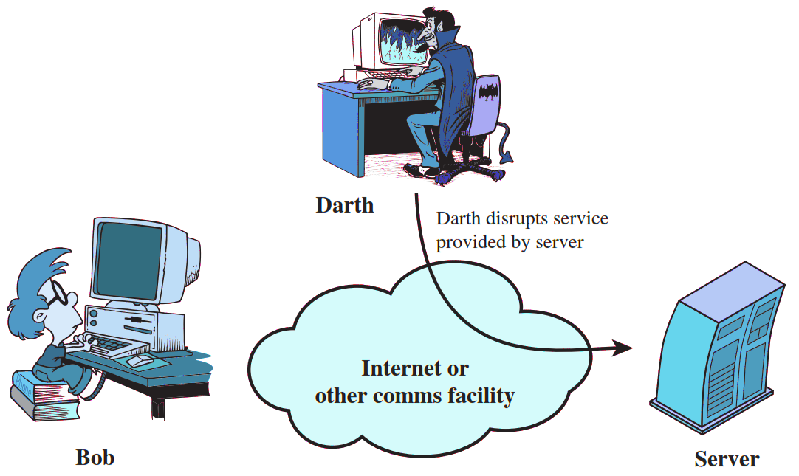
Denial of Service Attack (Active Attack)
The denial of service attack prevents the normal use or management of communications facilities.
Sending large number of packets to block the server.
Attack on Availability.

Slide 26
Security Service

Slide 27
Security Services (X.800)
X.800 standard defines a security service as a service that is provided by a protocol layer of communicating open systems and that ensures security of the systems or of data transfers.
Notes:
a processing or communication service that is provided by

Slide 28
Security Services
Authentication
Access Control
Data Confidentiality
Data Integrity
Non Repudiation
Peer Entity Authentication
Connection Confidentiality
Connection Integrity with recovery
Non Repudiation Origin
Data Origin Authentication
Connection less Confidentiality
Connection Integrity with out recovery
Non Repudiation Destination
Selective Repeat Confidentiality
Selective Field Connection Integrity
Traffic Flow Confidentiality
Connection less Integrity
Selective Field Connection less Integrity

Slide 29
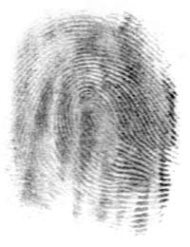
Authentication
Authentication is the assurance that the communicating entity is the one that it claims to be.
Peer Entity Authentication: Used in association with a logical connection (TCP) to provide confidence in the identity of the entities connected.
Data-Origin Authentication: In a connectionless (UDP) transfer, provides assurance that the source of received data is as claimed.
Who you are ? (biometrics)
Physical authentication
where you are ?
What you know ?
Password
One-time Password(OTP)
Notes:
Peer Entity Authentication: Used in association with a logical connection to provide confidence in the identity of the entities connected.
Data-Origin Authentication: In a connectionless transfer, provides assurance that the source of received data is as claimed.

Slide 30
Security Services
Authentication
Access Control
Data Confidentiality
Data Integrity
Non Repudiation
Peer Entity Authentication
Connection Confidentiality
Connection Integrity with recovery
Non Repudiation Origin
Data Origin Authentication
Connection less Confidentiality
Connection Integrity with out recovery
Non Repudiation Destination
Selective Repeat Confidentiality
Selective Field Connection Integrity
Traffic Flow Confidentiality
Connection less Integrity
Selective Field Connection less Integrity

Slide 31

Access Control
Access control is the prevention of unauthorized use of a resource
This service controls who can have access to a resource, under what conditions access can occur, and what those accessing the resource are allowed to do.
User A
User B
Human resources
network
Development
network

Slide 32
Security Services
Authentication
Access Control
Data Confidentiality
Data Integrity
Non Repudiation
Peer Entity Authentication
Connection Confidentiality
Connection Integrity with recovery
Non Repudiation Origin
Data Origin Authentication
Connection less Confidentiality
Connection Integrity with out recovery
Non Repudiation Destination
Selective Repeat Confidentiality
Selective Field Connection Integrity
Traffic Flow Confidentiality
Connection less Integrity
Selective Field Connection less Integrity

Slide 33
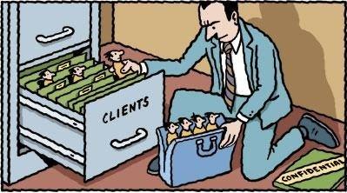
Data Confidentiality
Data confidentiality is the protection of data from unauthorized disclosure.
Connection Confidentiality: The protection of all user data on a connection.
Connectionless Confidentiality: The protection of all user data in a single data block.
Selective-Field Confidentiality: The confidentiality of selected fields within the user data on a connection or in a single data block.
Traffic-Flow Confidentiality: The protection of the information that might be derived from observation of traffic flows.

Slide 34
Security Services
Authentication
Access Control
Data Confidentiality
Data Integrity
Non Repudiation
Peer Entity Authentication
Connection Confidentiality
Connection Integrity with recovery
Non Repudiation Origin
Data Origin Authentication
Connection less Confidentiality
Connection Integrity with out recovery
Non Repudiation Destination
Selective Repeat Confidentiality
Selective Field Connection Integrity
Traffic Flow Confidentiality
Connection less Integrity
Selective Field Connection less Integrity

Slide 35

Data Integrity
Data integrity is the assurance that data received are exactly as sent by an authorized entity (i.e., contain no modification, insertion, deletion, or replay).
Channel
Alice
Bob
Both are same

Slide 36
Data Integrity (Cont…)
Connection Integrity with Recovery:
Provides integrity of all user data on a connection and detects any modification, insertion, deletion, or replay of any data with recovery attempted.
Connection Integrity without Recovery:
As above, but provides only detection without recovery.
Selective-Field Connection Integrity:
Provides integrity of selected fields within the user data and takes the form of determination of whether the selected fields have been modified, inserted, deleted, or replayed.

Slide 37
Data Integrity (Cont…)
Connectionless Integrity:
Provides integrity of a single connectionless data block and may take the form of detection of data modification.
Additionally, a limited form of replay detection may be provided.
Selective-Field Connectionless Integrity:
Provides integrity of selected fields within a single connectionless data block; takes the form of determination of whether the selected fields have been modified.

Slide 38
Security Services
Authentication
Access Control
Data Confidentiality
Data Integrity
Non Repudiation
Peer Entity Authentication
Connection Confidentiality
Connection Integrity with recovery
Non Repudiation Origin
Data Origin Authentication
Connection less Confidentiality
Connection Integrity with out recovery
Non Repudiation Destination
Selective Repeat Confidentiality
Selective Field Connection Integrity
Traffic Flow Confidentiality
Connection less Integrity
Selective Field Connection less Integrity

Slide 39
Non Repudiation
Nonrepudiation is the assurance that someone cannot deny something.
Typically, nonrepudiation refers to the ability to ensure that a communication cannot deny the authenticity of their signature on a document or the sending of a message that they originated.
Transfer Rs. 1,00,000
to Bank
After few days
User A
I have never requested to transfer Rs. 1,00,000
to Bank
Bank
Notes:
Hash functions, Digital signatures

Slide 40
Non Repudiation (Cont…)
Nonrepudiation-Origin:
Proof that the message was sent by the specified party.
Nonrepudiation-Destination:
Proof that the message was received by the specified party.

Slide 41
Security Mechanisms

Slide 42
Security Mechanisms (X.800)
Techniques designed to prevent, detect or recover from attacks
No single mechanism can provide all services.
Common in most mechanisms: cryptographic techniques
Specific security mechanisms: Integrated into the appropriate protocol layer in order to provide some of the OSI security services.
Pervasive security mechanisms: Not integrated to any particular OSI security service or protocol layer.

Slide 43
Security Mechanism (Specific security)
Encipherment: Hiding or covering data using mathematical algorithms.
Digital Signature: The sender can electronically sign the data and the receiver can electronically verify the signature.
Access Control: A variety of mechanisms that enforce access rights to resources.
Data Integrity: A variety of mechanisms used to assure the integrity of a data unit or stream of data units.

Slide 44
Security Mechanism (Specific security)
Authentication Exchange: Two entities exchange some messages to prove their identity to each other.
Traffic Padding: The insertion of bits into gaps in a data stream to frustrate traffic analysis attempts.
Routing Control: Selecting and continuously changing routes between sender and receiver to prevent opponent(attacker) from eavesdropping.
Notarization: The use of a trusted third party to assure and control the communication.

Slide 45
Model for Network Security
Trusted third party
(e.g., arbiter, distributer
of secret information)
Sender
Recipient
Security -related Transformation
Info.
Channel
Security -related Transformation
Message
Secure
Message
Secure
Message
Message
Secret
Information
Secret
Information
Opponent
(Attacker)

Slide 46
Symmetric Cipher Model

Slide 47
Encryption and Decryption
Sender
Hello
Encryption
f7#er
Decryption
Hello
Receiver

Slide 48



Symmetric Cipher Model (Conventional Encryption)
Secret key shared by sender and recipient
Secret key shared by sender and recipient
K
K
Transmitted
cipher text
Y = E(K, X)
X
X
Plaintext
input
Encryption Algorithm
(e.g. AES)
Decryption Algorithm
(reverse of encryption algorithm)
Plaintext
output
An original message is known as the plaintext, while the coded message is called the ciphertext.
The process of converting from plaintext to ciphertext is known as enciphering or encryption; restoring the plaintext from the ciphertext is deciphering or decryption.

Slide 49
Symmetric Cipher Model (Conventional Encryption)
Secret key shared by sender and recipient
Secret key shared by sender and recipient
K
K
Transmitted
cipher text
Y = E(K, X)
X
X
Plaintext
input
Encryption Algorithm
(e.g. AES)
Decryption Algorithm
(reverse of encryption algorithm)
Plaintext
output
Plaintext is the original intelligible message or data that is fed into the algorithm as input.
Encryption algorithm performs various substitutions and transformations on the plaintext.

Slide 50
Symmetric Cipher Model (Conventional Encryption)
Secret key shared by sender and recipient
Secret key shared by sender and recipient
K
K
Transmitted
cipher text
Y = E(K, X)
X
X
Plaintext
input
Encryption Algorithm
(e.g. AES)
Decryption Algorithm
(reverse of encryption algorithm)
Plaintext
output
The secret key is also input to the encryption algorithm.
The key is a value independent of the plaintext and of the algorithm.
The algorithm will produce a different output depending on the specific key being used at the time.

Slide 51
Symmetric Cipher Model (Conventional Encryption)
Secret key shared by sender and recipient
Secret key shared by sender and recipient
K
K
Transmitted
cipher text
Y = E(K, X)
X
X
Plaintext
input
Encryption Algorithm
(e.g. AES)
Decryption Algorithm
(reverse of encryption algorithm)
Plaintext
output
Ciphertext is the scrambled message produced as output.
It depends on the plaintext and the secret key.
The ciphertext is an apparently random stream of data and, as it stands, is unintelligible.

Slide 52
Symmetric Cipher Model (Conventional Encryption)
Secret key shared by sender and recipient
Secret key shared by sender and recipient
K
K
Transmitted
cipher text
Y = E(K, X)
X
X
Plaintext
input
Encryption Algorithm
(e.g. AES)
Decryption Algorithm
(reverse of encryption algorithm)
Plaintext
output
Decryption algorithm is essentially the encryption algorithm run in reverse.
It takes the ciphertext and the secret key and produces the original plaintext.

Slide 53
Terminology
Plaintext: original message
Ciphertext: encrypted or coded message
Encryption: convert from plaintext to ciphertext (enciphering)
Decryption: restore the plaintext from ciphertext (deciphering)
Key: information used in cipher known only to sender/receiver
Cipher: a particular algorithm (cryptographic system)
Cryptography: study of algorithms used for encryption
Cryptanalysis: study of techniques used for decryption without knowledge of plaintext
Cryptology: areas of cryptography and cryptanalysis

Slide 54
Requirements and Assumptions
Requirements for secure use of symmetric encryption:
Strong encryption algorithm: Given the algorithm and cipher text, an attacker cannot obtain key or plaintext.
Shared secret keys: sender and receiver both have shared a secret key; no-one else knows the key(keep it secret).
Assumptions:
Cipher is known
Secure channel to distribute keys

Slide 55
Cryptanalysis and Brute-Force Attack
Objective of attacker: recover key (not just message)
Approaches of attacker:
Cryptanalysis: This type of attack exploits the characteristics of the algorithm to attempt to derive a specific plaintext or to derive the key being used.
Brute-force attack: The attacker tries every possible key on a piece of cipher-text until an intelligible translation into plaintext is obtained.
On average, half of all possible keys must be tried to achieve success.

Slide 56
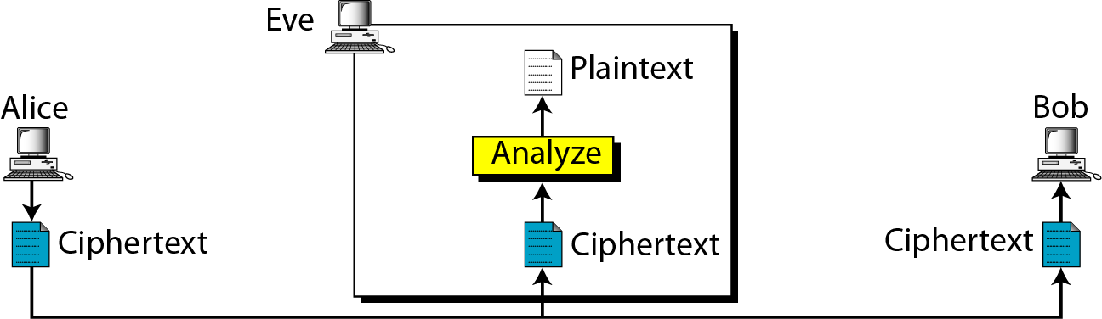
Attacks on Encrypted Messages
Type of Attack | Known to cryptanalyst
Ciphertext Only | Encryption algorithm, Ciphertext
Ciphertext-Only Attack
You only have the secret message.
You don't know anything else.
You try to guess the real message by patterns.
Example:
You find a coded note: “KHOOR”. You try common patterns and guess it means “HELLO”.

Slide 57
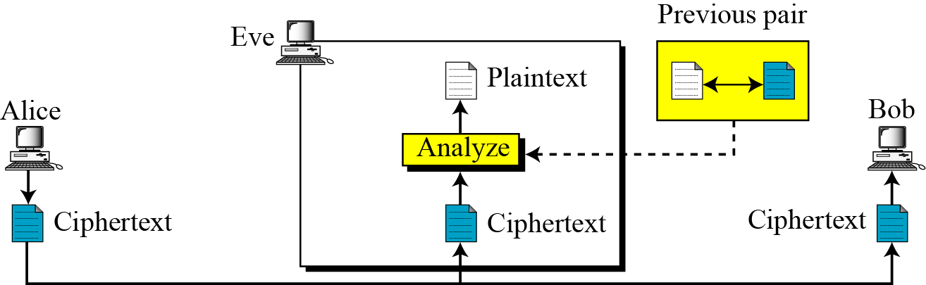
Attacks on Encrypted Messages
Type of Attack | Known to cryptanalyst
Known Plaintext | Encryption algorithm, Ciphertext, One or more plaintext-cipher text pairs formed with the secret key
Known-Plaintext Attack
You have one coded message AND you know what the real message was.
Using this, you try to crack more messages.
Example:
You see that “HELLO” becomes “KHOOR”. So you can figure out how the code works.

Slide 58
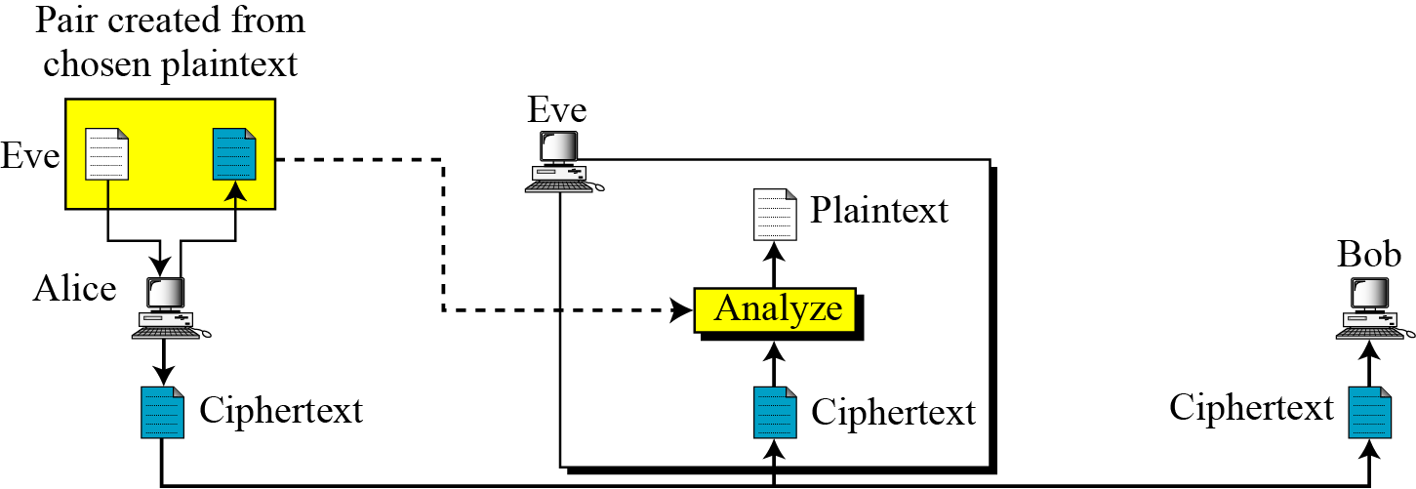
Attacks on Encrypted Messages
Type of Attack | Known to cryptanalyst
Chosen Plaintext | Encryption algorithm, Ciphertext, Plaintext message chosen by cryptanalyst
Chosen-Plaintext Attack
You can choose any sentence and ask the “secret box” to encrypt it.
Then you study how it changes.
Example:
You type “AAAAA” and the cipher gives “XDFGH”. Then you try “BBBBB”.
You observe the pattern and break the code.

Slide 59
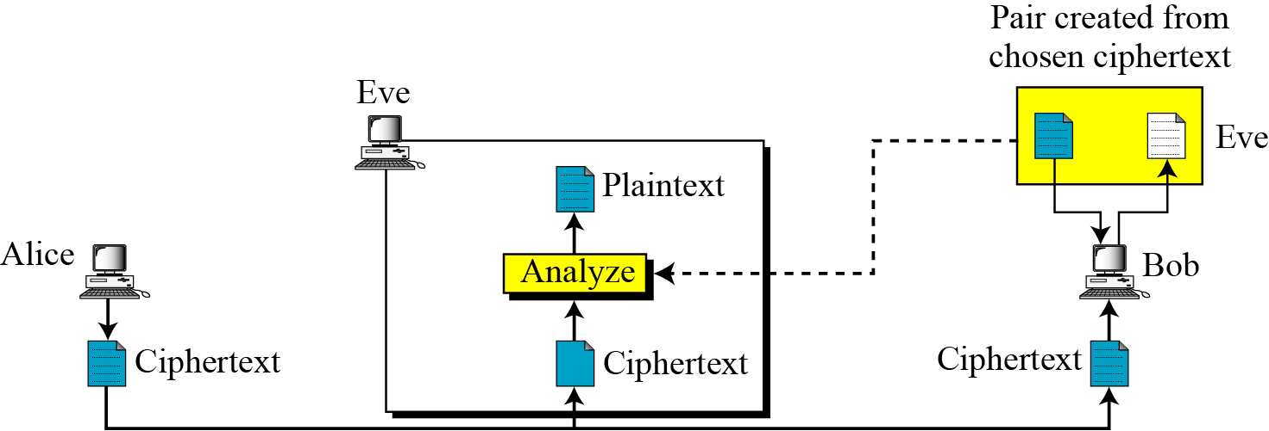
Attacks on Encrypted Messages
Type of Attack | Known to cryptanalyst
Chosen Ciphertext | Encryption algorithm, Ciphertext, Ciphertext chosen by cryptanalyst, with its corresponding decrypted plaintext generated with the secret key
Chosen-Ciphertext Attack
You can give the “secret box” a coded message, and it tells you the real message.
Using this power, you learn how to break the whole cipher.

Slide 60
Attacks on Encrypted Messages
Type of Attack | Known to cryptanalyst
Chosen text | Encryption algorithm, Ciphertext, Plaintext chosen by cryptanalyst, with its corresponding cipher-text generated with the secret key , Ciphertext chosen by cryptanalyst, with its corresponding decrypted plaintext generated with the secret key

Slide 61
Summary of Cryptanalysis
1. Ciphertext-Only Attack (COA)
Attacker has only the encrypted text (ciphertext).
Goal: guess the plaintext or key.
Hardest type of attack.
Example: Trying to break Caesar Cipher by frequency analysis.
2. Known-Plaintext Attack (KPA)
Attacker has some pairs of plaintext and ciphertext.
Uses this information to find the key.
Example: WWII Enigma was partially broken using known plaintext patterns like “Heil Hitler”.

Slide 62
Summary of Cryptanalysis – Cont.
3. Chosen-Plaintext Attack (CPA)
Attacker can choose any plaintext and obtain its ciphertext.
Helps analyze how the encryption behaves.
Example: Attacking RSA by encrypting chosen messages.
4. Chosen-Ciphertext Attack (CCA)
Attacker can provide ciphertexts and obtain the decrypted plaintext.
Very powerful attack.
Example: Bleichenbacher attack on RSA.

Slide 63
Substitution Techniques

Slide 64
Substitution Techniques
A substitution technique is one in which the letters of plaintext are replaced by other letters or by numbers or symbols.
If plaintext viewed as sequence of bits, replace plaintext bit patterns with ciphertext bit patterns.
Caesar Cipher
Monoalphabetic Cipher
Playfair Cipher
Hill Cipher
Polyalphabetic Ciphers
One-Time Pad

Slide 65
Caesar Cipher
The Caesar Cipher involves replacing each letter of the alphabet with the letter standing three places further down the alphabet.
For encryption algorithm is:
For decryption algorithm is:
C = E(k, P) = (P + k) mod 26
C = E(3, P) = (P + 3) mod 26
P = D(k, C) = (C - k) mod 26
P = D(3, C) = (C - 3) mod 26
Where: k=key, P=plaintext, C=ciphertext

Slide 66
Caesar Cipher (Cont…)
Let us assign a numerical equivalent to each letter:
a | b | c | d | e | f | g | h | i | j | k | l | m
0 | 1 | 2 | 3 | 4 | 5 | 6 | 7 | 8 | 9 | 10 | 11 | 12
n | o | p | q | r | s | t | u | v | w | x | y | z
13 | 14 | 15 | 16 | 17 | 18 | 19 | 20 | 21 | 22 | 23 | 24 | 25
C = E(3, P) = (P + 3) mod 26
Plain: a b c d e f g h i j k l m n o p q r s t u v w x y z
Cipher: d e f g h i j k l m n o p q r s t u v w x y z a b c
Example:
Plaintext: THE QUICK BROWN FOX
Ciphertext: WKH TXLFN EURZQ IRA

Slide 67
Caesar Cipher (Cont…)
Generalised Caesar Cipher
Allow shift by k positions.
Encryption :
Decryption :
Modulo for negative number is = N - (B%N)
Example :
-11 mod 26 = 15
26 - (11%26) = 15
C = E(k, P) = (P + k) mod 26
P = D(k, C) = (C - k) mod 26

Slide 68
Caesar Cipher Examples
Plaintext: networksecurity
Key: 7
Cipher:
Cipher: exxegoexsrgi
Key: 4
Plaintext :
Cipher: kyzj dvjjrxv zj vetipgkvu
Key: 17
Plain:
Plain: information security
Key: l
Cipher:
uladvyrzljbypaf
attackatonce
this message is encrypted
tyqzcxletzy dpnfctej

Slide 69
Brute force attack on Caesar Cipher
The encryption and decryption algorithms are known.
There are only 25 keys to try, e.g. k=1, k=2, …
The language of the plaintext is known and easily recognizable.

Slide 70
Brute force attack on Caesar Cipher
Ciphertext: ZNK WAOIQ HXUCT LUD
Key | Transformed text
1 | YMJ VZNHP GWTBS KTC
2 | XLI UYMGO FVSAR JSB
3 | WKH TXLFN EURZQ IRA
4 | VJG SWKEM DTQYP HQZ
5 | UIF RVJDL CSPXOGPY
6 | THE QUICK BROWN FOX
7 | SGD PTHBJ AQNVM ENW
8 | RFC OSGAI ZPMUL DMV
9 | QEB NRFZH YOLTK CLU
10 | PDA MQEYG XNKSJ BKT
11 | OCZ LPDXF WMJRI AJS
12 | NBY KOCWE VLIQH ZIR
13 | MAX JNBVD UKHPG YHQ
Key | Transformed text
14 | LZW IMAUC TJGOF XGP
15 | KYV HLZTB SIFNE WFO
16 | JXU GKYSA RHEMD VEN
17 | IWT FJXRZ QGDLC UDM
18 | HVS EIWQY PFCKB TCL
19 | GUR DHVPX OEBJA SBK
20 | FTQ CGUOW NDAIZ RAJ
21 | ESP BFTNV MCZHY QZI
22 | DRO AESMU LBYGX PYH
23 | CQN ZDRLT KAXFW OXG
24 | BPM YCQKS JZWEV NWF
25 | AOL XBPJR IYVDU MVE

Slide 71
Substitution Techniques
Caesar Cipher
Monoalphabetic Cipher
Playfair Cipher
Hill Cipher
Polyalphabetic Ciphers
One-Time Pad

Slide 72

2. Monoalphabetic Cipher (Simple substitution)
It is an improvement to the Caesar Cipher.
Instead of shifting the alphabets by some number, this scheme uses some permutation of the letters in alphabet.
Use a single alphabet for both plaintext and cipher text.
Example:
Cipher: kxlvzofemrj
Plaintext:
Try Brute force attack :
With 26 letters in alphabet, the possible permutations are 26! Keys ≈ (4x10²⁶).
Plain: a b c d e f g h i j k l m n o p q r s t u v w x y z
Cipher: y n l k x b s h m i w d p j r o q v f e a u g t z c
decryption

Slide 73
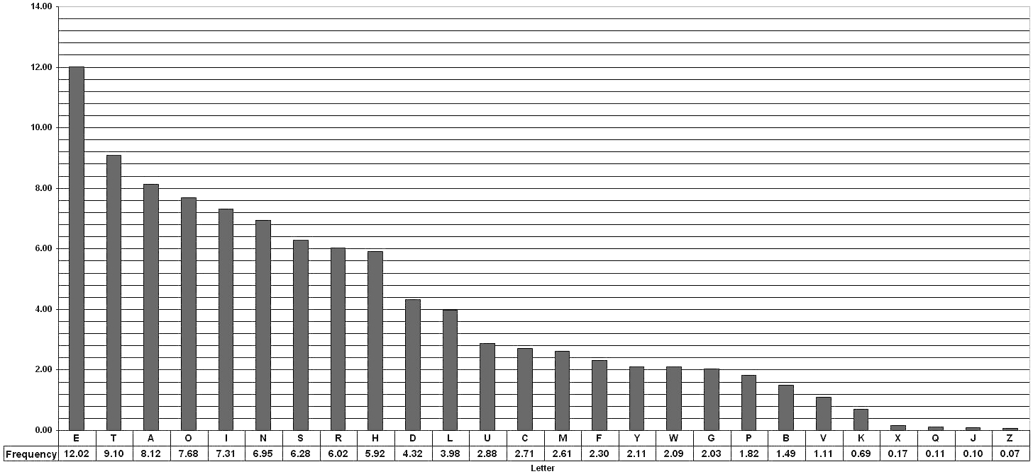
Relative Frequencies of the English Letters
Letter | Count | Letter | Frequency
E | 21912 | E | 12.02
T | 16587 | T | 9.10
A | 14810 | A | 8.12
O | 14003 | O | 7.68
I | 13318 | I | 7.31
N | 12666 | N | 6.95
S | 11450 | S | 6.28
R | 10977 | R | 6.02
H | 10795 | H | 5.92
D | 7874 | D | 4.32
L | 7253 | L | 3.98
U | 5246 | U | 2.88
C | 4943 | C | 2.71
M | 4761 | M | 2.61
F | 4200 | F | 2.30
Y | 3853 | Y | 2.11
W | 3819 | W | 2.09
G | 3693 | G | 2.03
P | 3316 | P | 1.82
B | 2715 | B | 1.49
V | 2019 | V | 1.11
K | 1257 | K | 0.69
X | 315 | X | 0.17
Q | 205 | Q | 0.11
J | 188 | J | 0.10
Z | 128 | Z | 0.07
Courtesy: https://pi.math.cornell.edu/~mec/2003-2004/cryptography/subs/frequencies.html

Slide 74
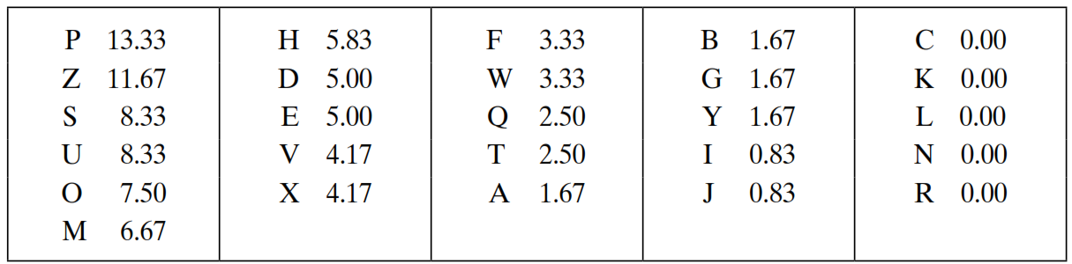
Attack on Monoalphabetic Cipher
The relative frequencies of the letters in the ciphertext (in %) are
In our ciphertext, the most common digram is ZW, which appears three times. So equate Z with t, W with h and P with e.
Now notice that the sequence ZWP appears in the ciphertext, and we can translate that sequence as “the.”
Ciphertext:
uzqsovuohxmopvgpozpevsgzwszopfpesxudbmetsxaizvuephzhmdzshzowsfpappdtsvpquzwymxuzuhsxepyepopdzszufpombzwpfupzhmdjudtmohmq

Slide 75
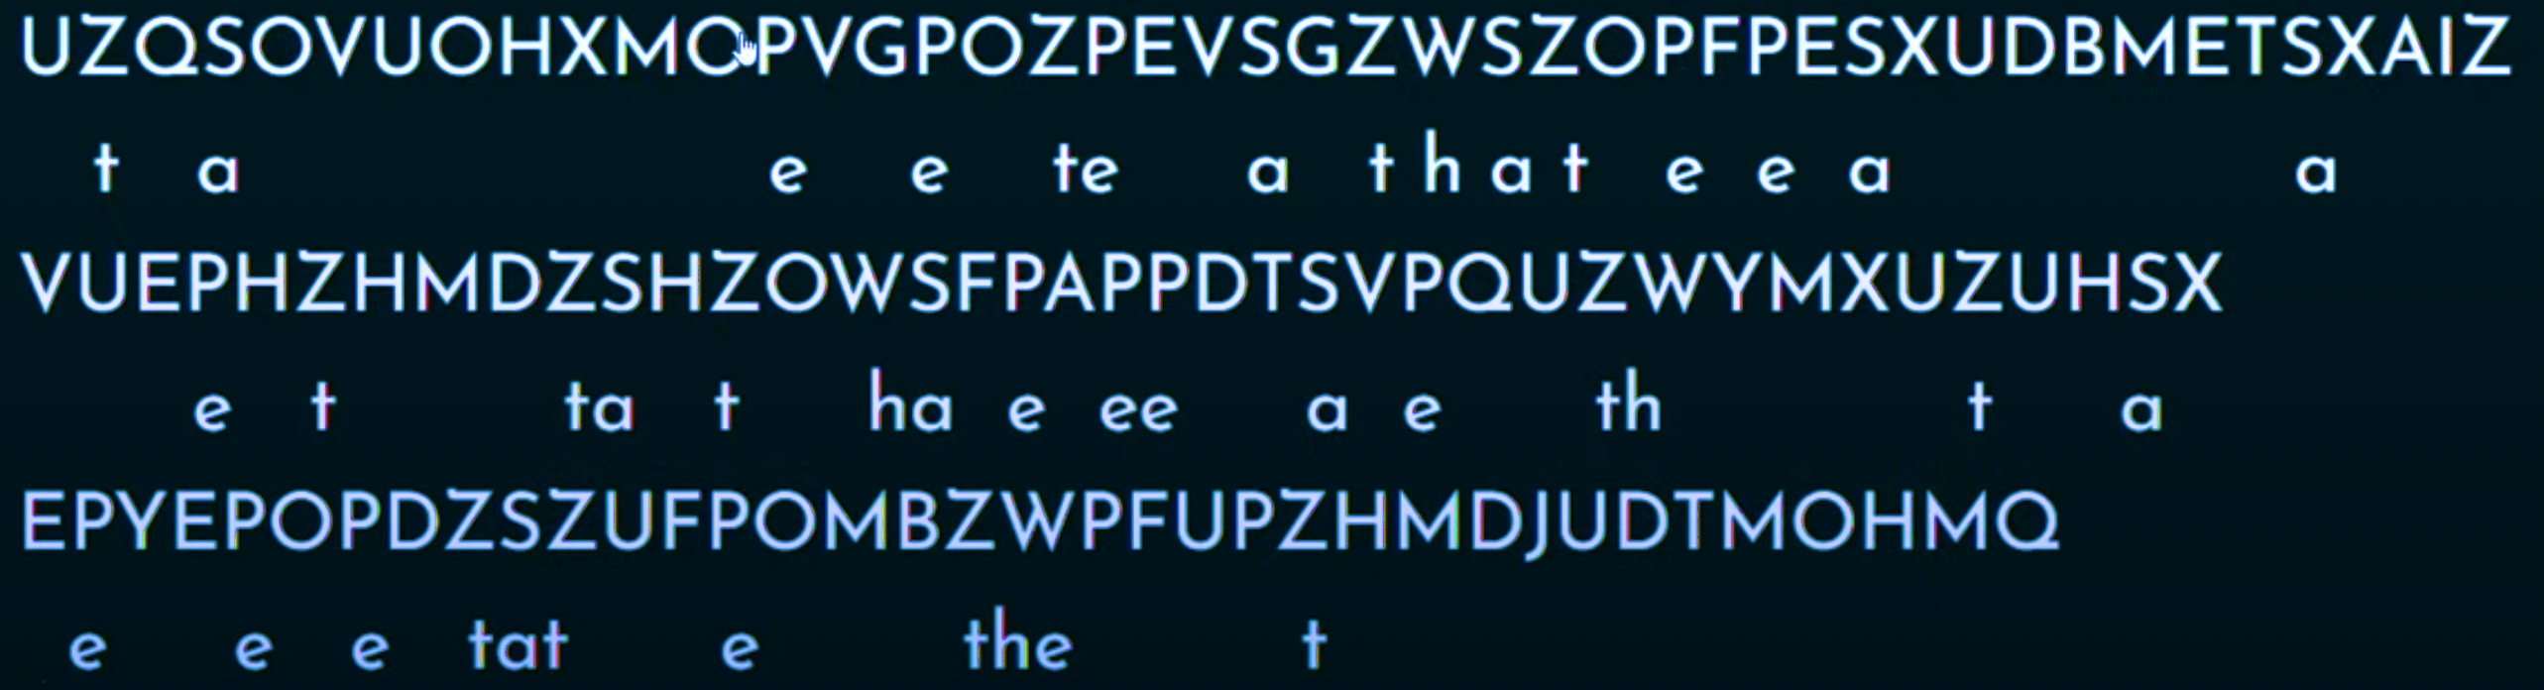
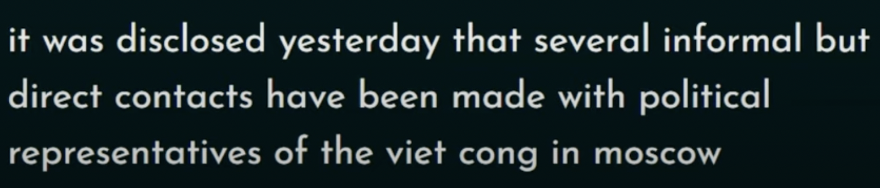
Example
v

Slide 76
Attack on Monoalphabetic Cipher (Cont…)
If the cryptanalyst knows the nature of the plaintext, then the analyst can exploit the regularities of the language.
The relative frequency of the letters can be determined and compared to a standard frequency distribution for English.
If the message were long enough, this technique alone might be sufficient, but because this is a relatively short message, we cannot expect an exact match.
Example:
Plain Text: Although the Death Star has been destroyed
Key: UAFJVQRLOIPBNDKHZSTXWMYCGE
Cipher Text: UBXLKWRL XLV JVUXL TXUS LUT AVVD JVTXSKGVJ

Slide 77
Substitution Techniques
Caesar Cipher
Monoalphabetic Cipher
Playfair Cipher
Hill Cipher
Polyalphabetic Ciphers
One-Time Pad

Slide 78
Playfair Cipher
The Playfair algorithm is based on a 5 × 5 matrix (key) of letters.
The matrix is constructed by filling in the letters of the keyword (minus duplicates) from left to right and from top to bottom, and then filling in the remainder of the matrix with the remaining letters in alphabetic order.
The letters I and J count as one letter.
O | C | U | R | E
N | A | B | D | F
G | H | I/J | K | L
M | P | Q | S | T
V | W | X | Y | Z
Example:
Keyword= OCCURRENCE
Plaintext= TALL TREES

Slide 79
Playfair Cipher - Encrypt Plaintext
Operate on pair of letters (digram) at a time.
Special: if digram with same letters appears, separate by special letter (e.g. x)
If there is an odd number of letters, then add uncommon letter to complete digram, a X/Z may be added to the last letter.
Plaintext= NETWORK
Plaintext= NE TW OR KX
Plaintext= TALL TREES
Plaintext= TA LX LT RE ES

Slide 80
Playfair Cipher - Encrypt Plaintext
Map each pair in key matrix
O | C | U | R | E
N | A | B | D | F
G | H | I/J | K | L
M | P | Q | S | T
V | W | X | Y | Z
Plaintext: TA LX LT RE ES
Ciphertext: PF IZ TZ EO RT
If the letters appear on the same row, replace them with the letters to their immediate right respectively, wrapping around to the left side of the row if necessary.
For example, using the table above, the letter pair RE would be encoded as EO.

Slide 81
Playfair Cipher - Encrypt Plaintext
Map each pair in key matrix
O | C | U | R | E
N | A | B | D | F
G | H | I/J | K | L
M | P | Q | S | T
V | W | X | Y | Z
Plaintext: TA LX LT RE ES
Ciphertext: PF IZ TZ EO RT
If the letters appear on the same column, replace them with the letters immediately below, wrapping around to the top if necessary.
For example, using the table above, the letter pair LT would be encoded as TZ.

Slide 82
Playfair Cipher - Encrypt Plaintext
Map each pair in key matrix
O | C | U | R | E
N | A | B | D | F
G | H | I/J | K | L
M | P | Q | S | T
V | W | X | Y | Z
Plaintext: TA LX LT RE ES
Ciphertext: PF IZ TZ EO RT
If the letters are on different rows and columns, replace them with the letters on other corner of the same row.
The order is important - the first letter of the pair should be replaced first.
For example, using the table above, the letter pair TA would be encoded as PF.

Slide 83
Playfair Cipher - Is it Breakable?
Better than monoalphabetic: relative frequency of digrams much less than of individual letters.
But relatively easy (digrams, trigrams, expected words)

Slide 84
Playfair Cipher Examples
Key= “engineering ” Plaintext= “test this process ”
Key= “keyword ” Plaintext= “come to the window”
Key= “moonmission ” Plaintext= “greet ”
E N G I R A B C D F H K L M O P Q S T U V W X Y Z | Encrypted Message: pi tu pm gt ue lf gp xg
K E Y W O R D A B C F G H I L M N P Q S T U V X Z | Encrypted Message: Lc nk zk vf yo gq ce bw
M O N I S A B C D E F G H K L P Q R T U V W X Y Z | Encrypted Message: hq cz du

Slide 85
Playfair Cipher Examples
Key: EXAMPLE
Ciphertext: UA ARBED EXAPO PR QNX AXANR
Pair: UA AR BE DE XA PO PR QN XA XA NR
Plaintext: we wi lx lm ex et at th ex ex it
Plaintext: we wilxl mexet at thex exit
Plaintext: we will meet at the exit
E | X | A | M | P
L | B | C | D | F
G | H | I/J | K | N
O | Q | R | S | T
U | V | W | Y | Z

Slide 86
Substitution Techniques
Caesar Cipher
Monoalphabetic Cipher
Playfair Cipher
Hill Cipher
Polyalphabetic Ciphers
One-Time Pad

Slide 87
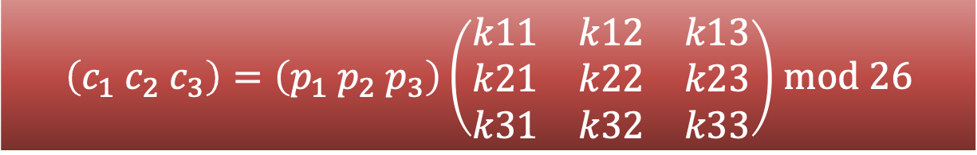
Hill Cipher
Hill cipher is based on linear algebra.
Each letter is represented by numbers from 0 to 25 and calculations are done using modulo 26.
Encryption and decryption can be given by the following formula:
Encryption:
Decryption:
C=PK mod 26
P=CK⁻¹ mod 26
$\left(c_{1} c_{2} c_{3}\right)=\left(p_{1} p_{2} p_{3}\right)\left(\begin{matrix}k11 & k12 & k13 \\ k21 & k22 & k23 \\ k31 & k32 & k33\end{matrix}\right)$ mod 26

Slide 88
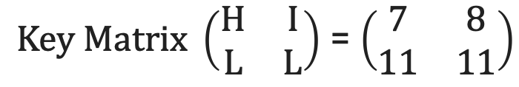
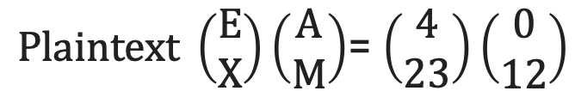
Hill Cipher Encryption
To encrypt a message using the Hill Cipher. We must first turn our keyword and plaintext into a matrix (a 2 x 2 matrix or a 3 x 3 matrix, etc.)
Example: Key = “HILL”, Plaintext = “EXAM”
a | b | c | d | e | f | g | h | i | j | k | l | m
0 | 1 | 2 | 3 | 4 | 5 | 6 | 7 | 8 | 9 | 10 | 11 | 12
n | o | p | q | r | s | t | u | v | w | x | y | z
13 | 14 | 15 | 16 | 17 | 18 | 19 | 20 | 21 | 22 | 23 | 24 | 25
$Key Matrix \left(\begin{matrix}H & I \\ L & L\end{matrix}\right)$ = $\left(\begin{matrix}7 & 8 \\ 11 & 11\end{matrix}\right)$
$Plaintext \left(\begin{matrix}E \\ X\end{matrix}\right)\left(\begin{matrix}A \\ M\end{matrix}\right)$= $\left(\begin{matrix}4 \\ 23\end{matrix}\right)\left(\begin{matrix}0 \\ 12\end{matrix}\right)$
Notes:
Exam

Slide 89
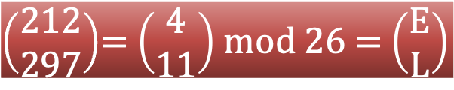
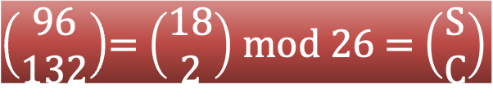
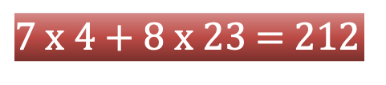
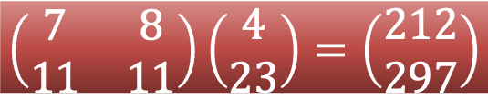
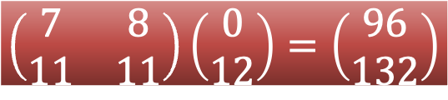
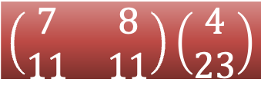
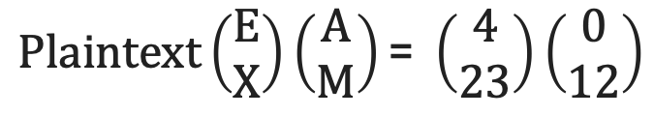
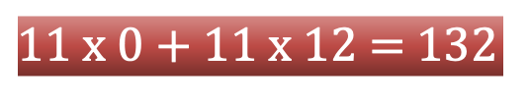
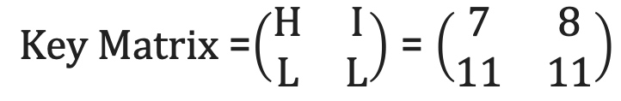
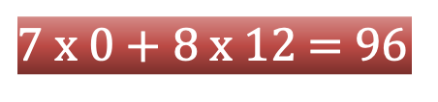
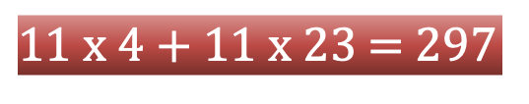
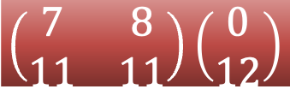
Hill Cipher Encryption (Cont…)
$Key Matrix$=$\left(\begin{matrix}H & I \\ L & L\end{matrix}\right)$ = $\left(\begin{matrix}7 & 8 \\ 11 & 11\end{matrix}\right)$
$$Plaintext\left(\begin{matrix}E \\ X\end{matrix}\right)\left(\begin{matrix}A \\ M\end{matrix}\right)\text{= }\left(\begin{matrix}4 \\ 23\end{matrix}\right)\left(\begin{matrix}0 \\ 12\end{matrix}\right)$$
C=PK mod 26
$$\left(\begin{matrix}7 & 8 \\ 11 & 11\end{matrix}\right)\left(\begin{matrix}4 \\ 23\end{matrix}\right)$$
$$\left(\begin{matrix}7 & 8 \\ 11 & 11\end{matrix}\right)\left(\begin{matrix}0 \\ 12\end{matrix}\right)$$
$7$ x 4 + 8 x 23 = 212
$7$ x 0 + 8 x 12 = 96
$11$ x 4 + 11 x 23 = 297
$11$ x 0 + 11 x 12 = 132
$$\left(\begin{matrix}7 & 8 \\ 11 & 11\end{matrix}\right)\left(\begin{matrix}4 \\ 23\end{matrix}\right)=\left(\begin{matrix}212 \\ 297\end{matrix}\right)$$
$$\left(\begin{matrix}7 & 8 \\ 11 & 11\end{matrix}\right)\left(\begin{matrix}0 \\ 12\end{matrix}\right)=\left(\begin{matrix}96 \\ 132\end{matrix}\right)$$
$\left(\begin{matrix}212 \\ 297\end{matrix}\right)$= $\left(\begin{matrix}4 \\ 11\end{matrix}\right)$ mod 26 = $\left(\begin{matrix}E \\ L\end{matrix}\right)$
$\left(\begin{matrix}96 \\ 132\end{matrix}\right)$= $\left(\begin{matrix}18 \\ 2\end{matrix}\right)$ mod 26 = $\left(\begin{matrix}S \\ C\end{matrix}\right)$
Ciphertext = “ELSC”

Slide 90
Hill Cipher Decryption
Step 1: Find Inverse of key matrix
Step 2: Multiply the Multiplicative Inverse of the Determinant by the Adjoin Matrix
Step 3: Multiply inverse key matrix with ciphertext matrix to obtain plaintext matrix
P=CK⁻¹ mod 26

Slide 91
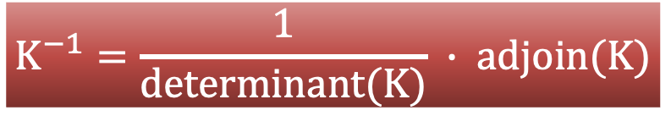
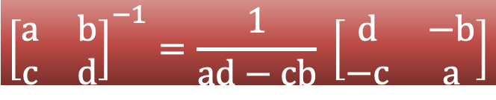
Step 1: Inverse of key matrix
2 X 2 inverse of matrix
$${\left[\begin{matrix}a & b \\ c & d\end{matrix}\right]}^{−1}=\frac{1}{ad−cb} \left[\begin{matrix}d & −b \\ −c & a\end{matrix}\right]$$
3 X 3 inverse of matrix
$$K^{−1}=\frac{1}{determinant(K)} ∙ adjoin(K)$$

Slide 92
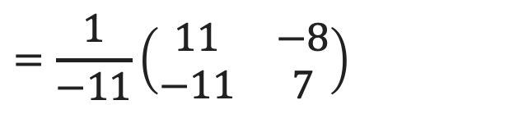
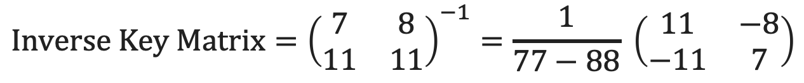
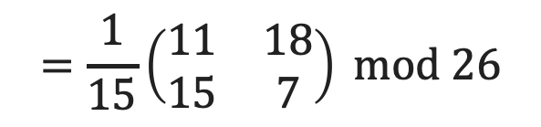
Step 1: Inverse of key matrix
$$Inverse Key Matrix={\left(\begin{matrix}7 & 8 \\ 11 & 11\end{matrix}\right)}^{−1}=\frac{1}{77−88} \left(\begin{matrix}11 & −8 \\ −11 & 7\end{matrix}\right)$$
$$=\frac{1}{−11}\left(\begin{matrix}11 & −8 \\ −11 & 7\end{matrix}\right)$$
-11 mod 26 = 15
Because, modulo for negative number is = N- (B%N)
= 26 – (11%26)
$$=\frac{1}{15}\left(\begin{matrix}11 & 18 \\ 15 & 7\end{matrix}\right) mod 26$$

Slide 93
Step 2: Modular (Multiplicative) inverse
The inverse of a number A is 1/A since A * 1/A = 1
e.g. the inverse of 5 is 1/5
In modular arithmetic we do not have a division operation.
The modular inverse of A (mod C) is A⁻¹
(A * A⁻¹) ≡ 1 (mod C)
Example:
The modular inverse of A mod C is the B value that makes
A * A⁻¹ mod C = 1
A = 3, C = 11
Since (3*4) mod 11 = 1, 4 is modulo inverse of 3
A = 10, C = 17 , A⁻¹ = ?
12

Slide 94


Step 2: Modular (Multiplicative) inverse
Determinants’ multiplicative inverse Modulo 26
Determinant | 1 | 3 | 5 | 7 | 9 | 11 | 15 | 17 | 19 | 21 | 23 | 25
Inverse Modulo 26 | 1 | 9 | 21 | 15 | 3 | 19 | 7 | 23 | 11 | 5 | 17 | 25
$$=\frac{1}{15}\left(\begin{matrix}11 & 18 \\ 15 & 7\end{matrix}\right) mod 26$$
Multiplicative inverse of $\frac{1}{15}$ is 7

Slide 95
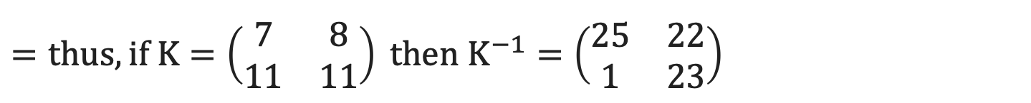
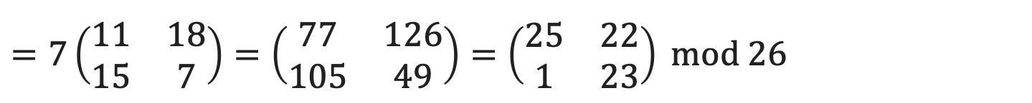
Step 2: Multiply with adjoin of matrix
$$=7\left(\begin{matrix}11 & 18 \\ 15 & 7\end{matrix}\right)=\left(\begin{matrix}77 & 126 \\ 105 & 49\end{matrix}\right)=\left(\begin{matrix}25 & 22 \\ 1 & 23\end{matrix}\right) mod 26$$
$$=thus, if K=\left(\begin{matrix}7 & 8 \\ 11 & 11\end{matrix}\right) then K^{−1}=\left(\begin{matrix}25 & 22 \\ 1 & 23\end{matrix}\right)$$
X%Y = X-(X/Y)*Y
77%26 = 77-(77/26)*26
= 77-(2)*26
= 77-52
= 25

Slide 96
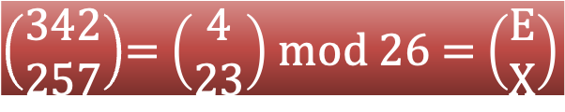
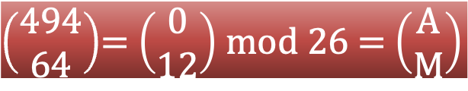
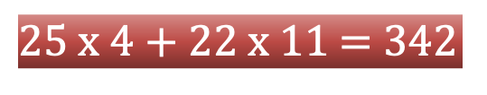
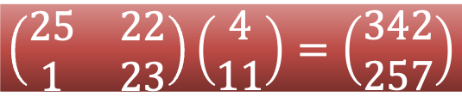
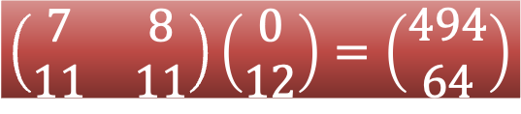
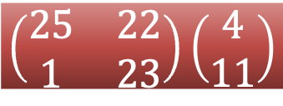
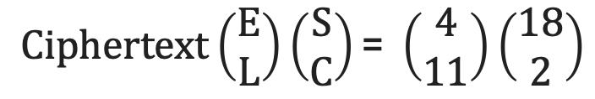
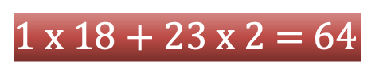




Hill Cipher Encryption (Cont…)
$Inverse Key Matrix$=$\left(\begin{matrix}25 & 22 \\ 1 & 23\end{matrix}\right)$
$$Ciphertext\left(\begin{matrix}E \\ L\end{matrix}\right)\left(\begin{matrix}S \\ C\end{matrix}\right)\text{= }\left(\begin{matrix}4 \\ 11\end{matrix}\right)\left(\begin{matrix}18 \\ 2\end{matrix}\right)$$
P=CK⁻¹ mod 26
$$\left(\begin{matrix}25 & 22 \\ 1 & 23\end{matrix}\right)\left(\begin{matrix}4 \\ 11\end{matrix}\right)$$
$$\left(\begin{matrix}25 & 22 \\ 1 & 23\end{matrix}\right)\left(\begin{matrix}18 \\ 2\end{matrix}\right)$$
$25$ x 4 + 22 x 11 = 342
$25$ x 18 + 22 x 2 = 494
$1$ x 4 + 23 x 11 = 257
$1$ x 18 + 23 x 2 = 64
$$\left(\begin{matrix}25 & 22 \\ 1 & 23\end{matrix}\right)\left(\begin{matrix}4 \\ 11\end{matrix}\right)=\left(\begin{matrix}342 \\ 257\end{matrix}\right)$$
$$\left(\begin{matrix}7 & 8 \\ 11 & 11\end{matrix}\right)\left(\begin{matrix}0 \\ 12\end{matrix}\right)=\left(\begin{matrix}494 \\ 64\end{matrix}\right)$$
$\left(\begin{matrix}342 \\ 257\end{matrix}\right)$= $\left(\begin{matrix}4 \\ 23\end{matrix}\right)$ mod 26 = $\left(\begin{matrix}E \\ X\end{matrix}\right)$
$\left(\begin{matrix}494 \\ 64\end{matrix}\right)$= $\left(\begin{matrix}0 \\ 12\end{matrix}\right)$ mod 26 = $\left(\begin{matrix}A \\ M\end{matrix}\right)$
Plaintext = “EXAM”

Slide 97
Hill Cipher Examples
Key: Hill Plaintext: short example
Ciphertext: APADJ TFTWLFJ
Key: ACBA Plaintext: DR GREER ROCKS (A=1, B=2, … )
Ciphertext: FZIFTOTBXGPO
Key: DACB Ciphertext: SAKNOXAOJ (A=1,B=2,…)
Plaintext: WELOVEMATH

Slide 98


Practice Example
Plain Text is hi
Take Example Plaintext: "CAT"

Slide 99
Substitution Techniques
Caesar Cipher
Monoalphabetic Cipher
Playfair Cipher
Hill Cipher
Polyalphabetic Ciphers
One-Time Pad

Slide 100
Polyalphabetic Cipher
Monoalphabetic cipher encoded using only one fixed alphabet
Polyalphabetic cipher is a substitution cipher in which the cipher alphabet for the plain alphabet may be different at different places during the encryption process.
Vigenere cipher
Vernam cipher

Slide 101

Plaintext
Key
PT = HELLO
KEY = GMGMG
CT = NQRXU

Slide 102
Vigenere Cipher
Keyword : DECEPTIVE
Key : DECEPTIVEDECEPTIVEDECEPTIVE
Plaintext : WEAREDISCOVEREDSAVEYOURSELF
Ciphertext : ZICVTWQNGRZGVTWAVZHCQYGLMGJ
Key must be as long as plaintext else repeat a keyword
$$C= \left(P_{1}+K_{1},P_{2}+K_{2}, …P_{m}+K_{m}\right)mod 26$$
$$P= \left(C_{1}−K_{1},C_{2}−K_{2}, …C_{m}−K_{m}\right)mod 26$$
An analyst looking at only the ciphertext would detect the repeated sequences VTW at a displacement of 9 and make the assumption that the keyword is either three or nine letters in length.
This system is referred as an auto key system
Keyword : DECEPTIVE
Key : DECEPTIVEWEAREDISCOVEREDSAV
Plaintext : WEAREDISCOVEREDSAVEYOURSELF

Slide 103
Vigenere Cipher
Multiple ciphertext letters for each plaintext letter.
Weakness is repeating, structured keyword.
Example:
Plaintext: internet technologies
Key: cryptography
Cipher using standard algorithm:
Cipher using auto key system:
kertkbkk ttjfpfjdzm
kertkbkk ttjfvbesxl

Slide 104

Vernam Cipher
The ciphertext is generated by applying the logical XOR operation to the individual bits of plaintext and the key stream.

Slide 105
Substitution Techniques
Caesar Cipher
Monoalphabetic Cipher
Playfair Cipher
Hill Cipher
Polyalphabetic Ciphers
One-Time Pad

Slide 106
One time pad
Similar to Vigenere, but use random key as long as plaintext.
Only known scheme that is unbreakable (unconditional security)
Ciphertext has no statistical relationship with plaintext.
Given two potential plaintext messages, attacker cannot identify the correct message.
Two practical limitations:
Diﬃcult to provide large number of random keys
Distributing unique long random keys is diﬃcult

Slide 107
One time pad – Cont.
Attacker knows the ciphertext:
ANKYODKYUREPFJBYOJDSPLREYIUNOFDOIUERFPLUYTS
Attacker tries all possible keys.
Two examples:
key1: pxlmvmsydofuyrvzwctnlebnecvgdupahfzzlmnyih
Plaintext1: mr mustard with the candlestick in the hall
key2: mfugpmiydgaxgoufhklllmhsqdqogtewbqfgyovuhwt
Plaintext2: miss scarlet with the knife in the library
There are many other legible plaintexts obtained with other keys. No way for attacker to know the correct plaintext

Slide 108


Slide 109
Transposition Techniques

Slide 110
Transposition Techniques
A transposition cipher does not substitute one symbol for another, instead it changes the location of the symbols.
The simplest such cipher is the rail fence technique, in which the plaintext is written down as a sequence of diagonals and then read off as a sequence of rows.
For example, to send the message “Meet me at the park” to Bob, Alice writes
M
E
M
A
T
E
A
K
She then creates the ciphertext:
E
T
E
T
H
P
R
MEMATEAK
ETETHPR

Slide 111
Rail Fence Transposition
Easy to break: letter frequency analysis to determine depth.
Example:
Plaintext: internettechnology
Depth: 3
Cipher:
IRTNGNENTEHOOYTECL
I |  |  |  | R |  |  |  | T |  |  |  | N |  |  |  | G
 | N |  | E |  | N |  | T |  | E |  | H |  | O |  | O |  | Y
 |  | T |  |  |  | E |  |  |  | C |  |  |  | L

Slide 112
Rows/Columns Transposition
Plaintext letters written in rows.
Ciphertext obtained by reading column-by-column, but re-arranged.
Key determines order of columns to read.
Easy to break using letter frequency (try diﬀerent column orders)
Key: 4 3 1 2 5 6 7
Plaintext: A T T A C K P
O S T P O N E
D U N T I L T
W O A M X Y Z
Ciphertext:
TTNA
APTM
TSUO
AODW
COIX
KNLY
PETZ

Slide 113
Rows/Columns Transposition
Transposition ciphers can be made stronger by using multiple stages of transposition
Plaintext: securityandcryptography
Key: 315624
Ciphertext:
Transpose again using same key:
Ciphertext:
EYYARDOYSTRRICGCAPPUNTH
YYCURRAHEOIPDRPYSGNATCT

Slide 114
Stream Cipher & Block Cipher

Slide 115


Stream Cipher
A stream cipher is one that encrypts a digital data stream one bit or one byte at a time.
Examples of classical stream ciphers are Autokeyed Vigenère cipher and Vernam cipher.
ENCRYPTION
DECRYPTION
Key(k_{i})
010101
Bit-stream
Generation
algorithm
Key(k_{i})
010101
Bit-stream
Generation
algorithm
K_{i}
K_{i}
Plaintext(p_{i})
100101
$$⊕$$
Ciphertext(c_{i})
110000
$$⊕$$
Plaintext(p_{i})
100101

Slide 116

Block Cipher
A block cipher is one in which a block of plaintext is treated as a whole and used to produce a ciphertext block of equal length.
Typically, a block size of 64 or 128 bits is used.
Examples:
Feistel Cipher
DES
Triple DES
AES

Slide 117
Block Cipher – Cont.
b bits
b bits
Plaintext
Ciphertext
Key
(K)
Encryption Algorithm
Key
(K)
Decryption Algorithm
Ciphertext
Plaintext
b bits
b bits

Slide 118
Diffusion and Confusion
Confusion hides the relationship between the ciphertext and the key.
This is achieved by the use of a complex substitution algorithm.
Diffusion hides the relationship between the ciphertext and the plaintext.
This is achieved by having each plaintext digit affect the value of many ciphertext digits.
X1=0010 1011
Diffusion
Y1=1011 1001
Y2=0110 1100
X2=0000 1011
Single bit flip
Many bit flips

Slide 119
Block Cipher Structure
Design principle of block cipher

Slide 120
Plaintext (2w bits)
L₀
w bits
w bits
R₀
Round 1
K₁
Feistel Cipher Structure Or
Block Cipher Structure
F
L₁
R₁
Round i
K_{i}
F
L_{i}
R_{i}
Round n
K_{n}
L_{n}
R_{n}
F
L_{n+1}
R_{n+1}
L_{n}
R_{n}
Ciphertext (2w bits)

Slide 121

Plaintext (2w bits)
Feistel Cipher Structure Or Block Cipher Structure
L₀
w bits
w bits
R₀
Round 1
K₁
Plaintext is split into 32-bit halves L_{i} and R_{i}
F
L₁
R₁
R_{i} is fed into the function F.
The output of function F is then XORed with L_{i}
Round n
K_{n}
Left and right half are swapped.
F
L_{n}
R_{n}
R_{i} = L _{i -1} $⊕F$(R _{i – 1}, K_{i})
L_{i} = R _{i – 1}
L_{n+1}
R_{n+1}
Ciphertext (2w bits)

Slide 122
Feistel Cipher Structure
Input plaintext block of length 2w bits
key K = n bits , Sub-keys: K₁, K₂, …, K_{n} (Derived from K)
All rounds have the same structure.
A substitution is performed by taking exclusive-OR on left half(Li) of the data and the output of round function F which has inputs right half(Ri) and sub key ki.
A permutation is performed that consists of interchange of two halves of data.
This structure is called Substitution-Permutation Network (SPN)

Slide 123
Feistel Network Factors
Block size: Common block size of 64-bit. However, the new algorithms uses a 128-bit, 256-bit block size.
Key size: Key sizes of 64 bits or less are now widely considered to be insufficient, These days at least 128 bit, more better, e.g. 192 or 256 bit
Number of rounds: A typical size is 16 rounds.
Round function F: Again, greater complexity generally means greater resistance to cryptanalysis.
Subkey generation algorithm: Greater complexity in this algorithm should lead to greater difficulty of cryptanalysis.

Slide 124









Feistel Encryption & Decryption
Prove that output of first round of Decryption is equal to 32-bit swap of input of 16th round of Encryption.
LD₁=RE₁₅ & RD₁=LE₁₅
On Encryption Side:
$${LE}_{16}={RE}_{15}$$
$${RE}_{16}={LE}_{15} ⊕F({RE}_{15},K_{16})$$
On Decryption Side:
$${LD}_{1}={RD}_{0}={LE}_{16}={RE}_{15}$$
$${RD}_{1}={LD}_{0} ⊕F\left({RD}_{0},K_{16}\right)$$
$$={RE}_{16} ⊕F\left({RE}_{15},K_{16}\right)$$
$$={[LE}_{15} ⊕F\left({RE}_{15},K_{16}\right)] ⊕F\left({RE}_{15},K_{16}\right)$$
XOR Associativity Property
$$∵\left[A⊕B\right]⊕C=A⊕[B⊕C]$$
$$Thus,$$
$${LD}_{1}={RE}_{15} \&{ RD}_{1}={LE}_{15}$$

Slide 125
Information & Network Security (INS)
DU #2301CS631
Prof. Maulik D Trivedi
Computer Engineering Department
maulik.trivedi@darshan.ac.in
9998 265 805

